Slide 1
The Persian Wars

Slide 3
Herodotus: The Father of History

Slide 4
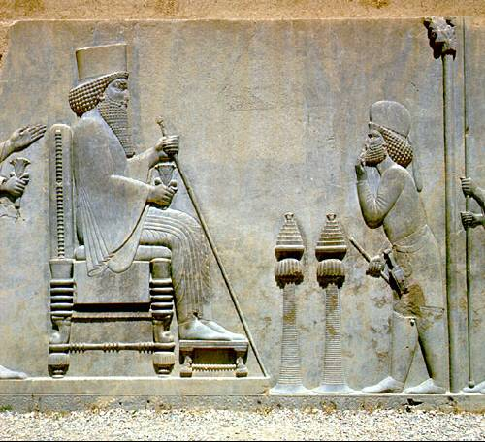
The Persian Empire

Slide 5
Persian Power

Slide 6
East Meets West

Slide 7
Ionian Revolt

Slide 8
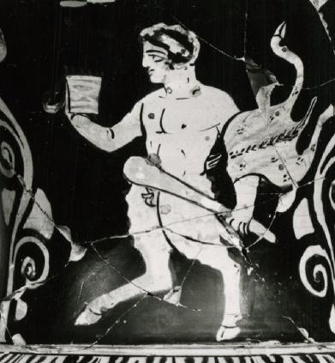
Darius’ invasion of Greece and the battle of Marathon 490 BC

Slide 9
Xerxes’ Invasion of Greece

Slide 10
The Persian march into Greece

Slide 11
Xerxes’ Invasion. The battles of Thermopylae and Salamis 480 BC

Slide 12
The battle of Plataea. The final defeat of Xerxes’ invasion 479 BC

